Slide 1
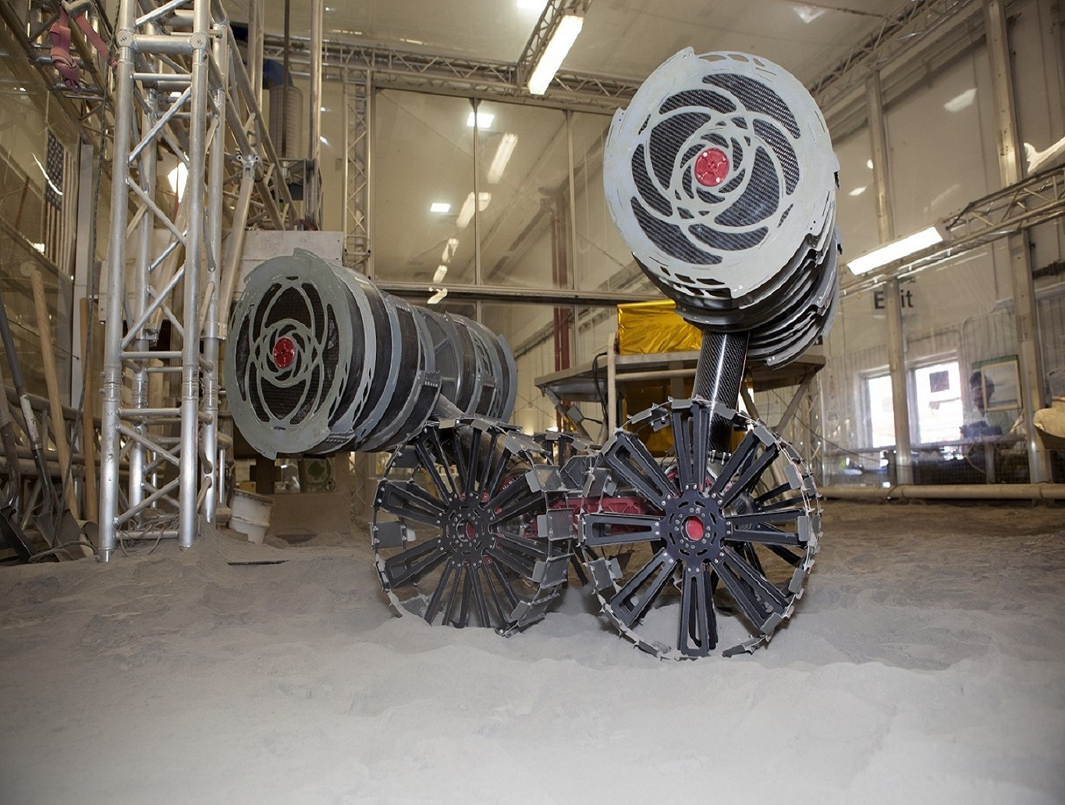
RE-RASSOR ARM
Grace Busch | Evaline Cantarero | Jackson Davis | David Nowicki
TEAM 505
Notes:
evaline

Slide 2
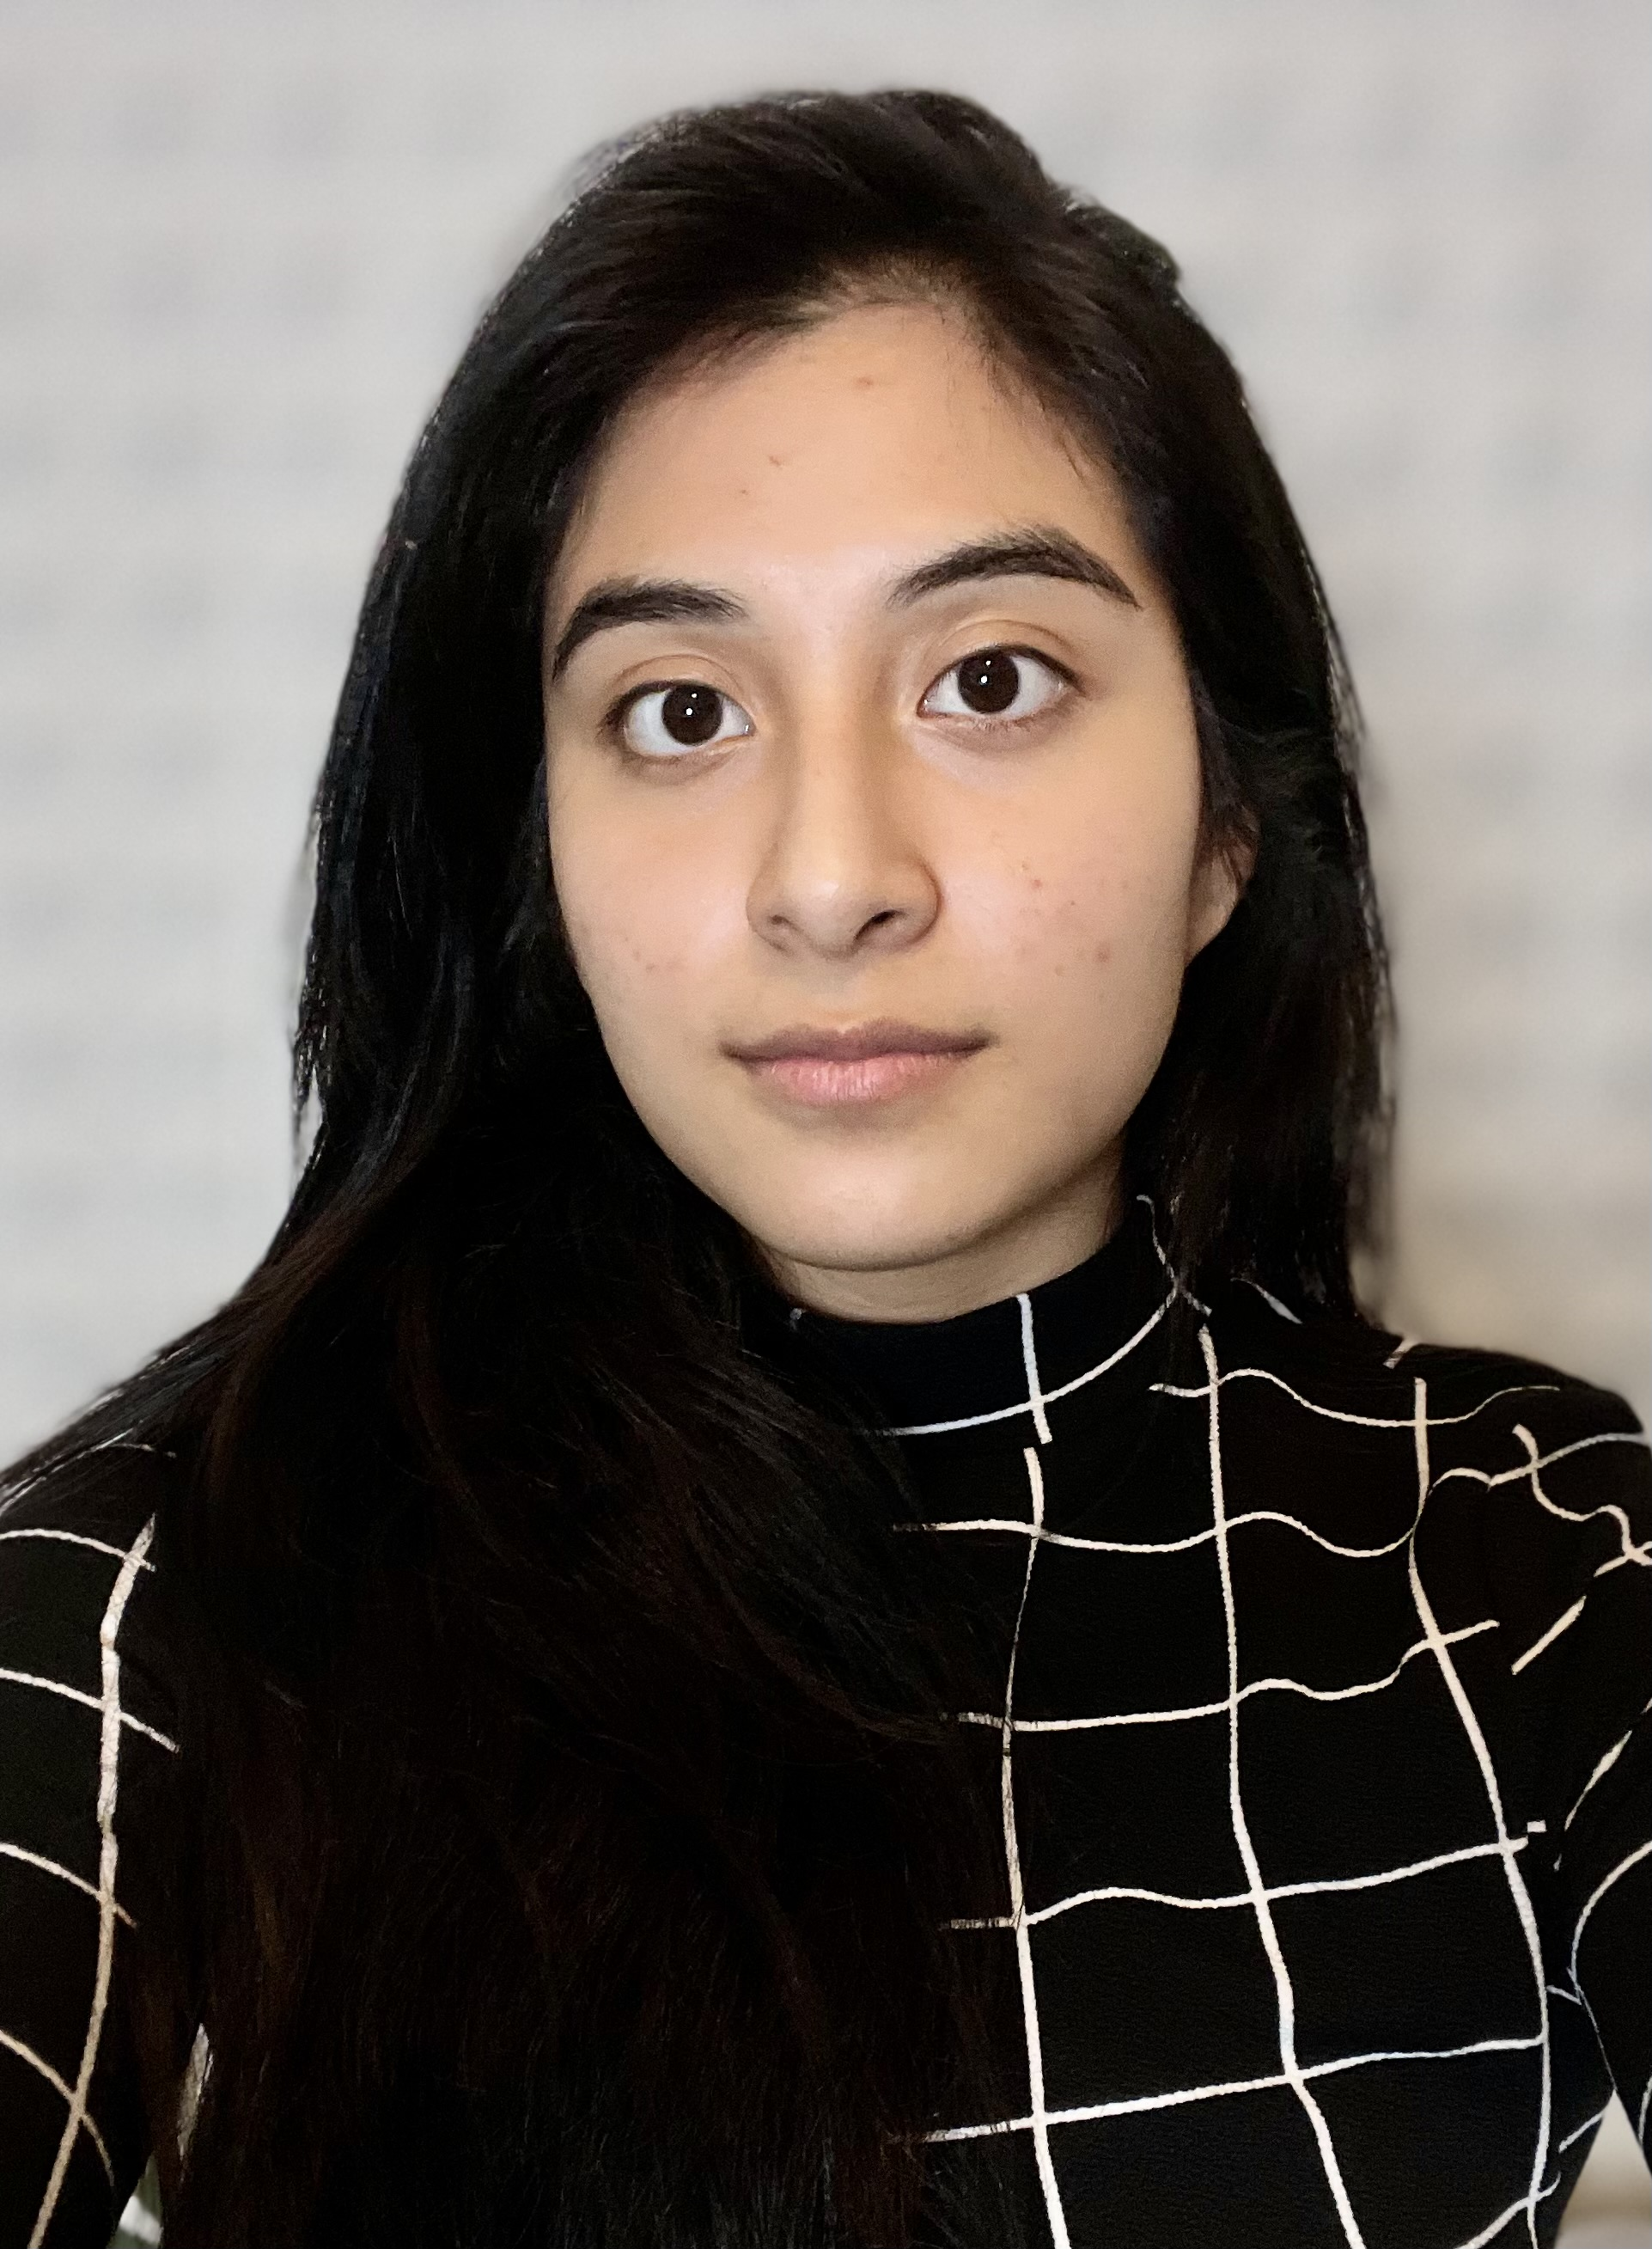

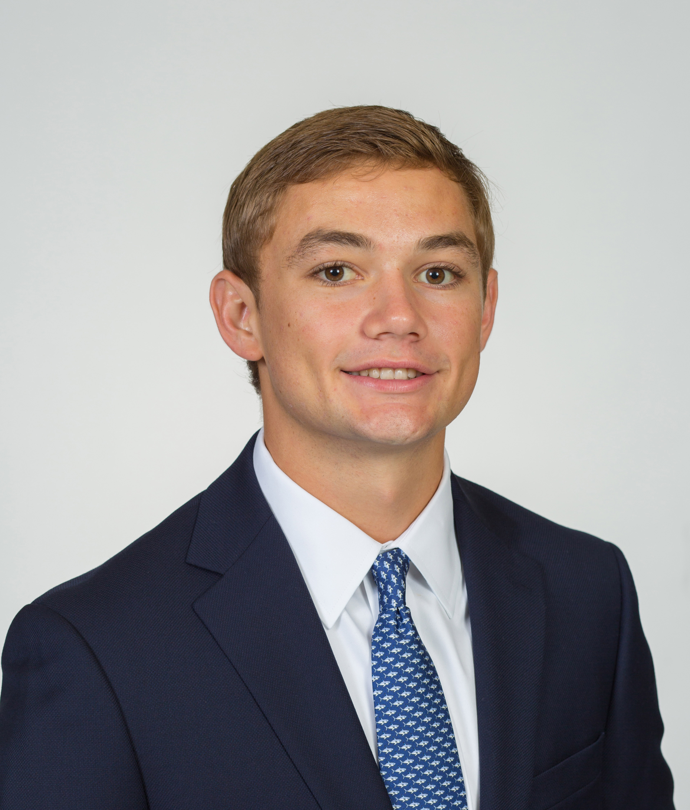
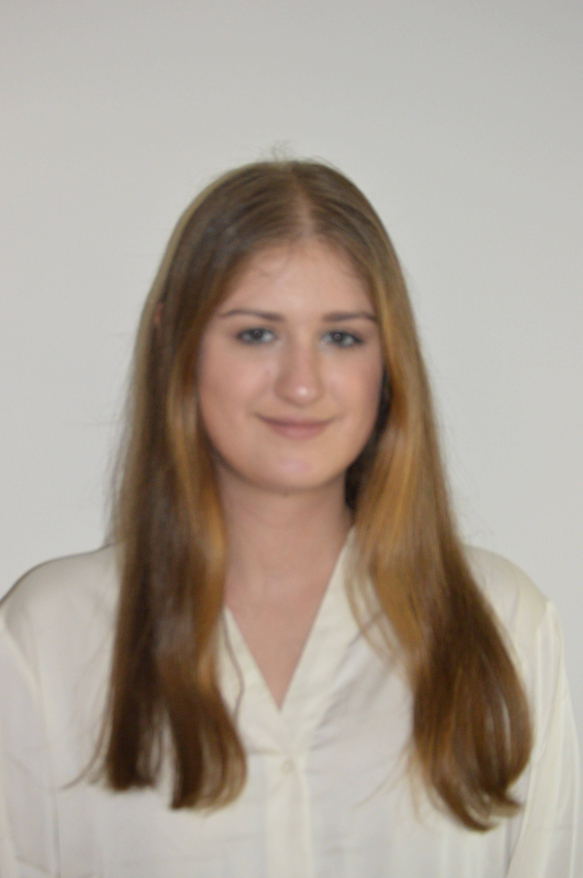
Meet Team 505
Grace Busch
Dynamic System
Engineer
Evaline Cantarero
Mechatronics
Engineer
Jackson Davis
Materials Engineer
David Nowicki
Design
Engineer
Evaline Cantarero

Slide 3

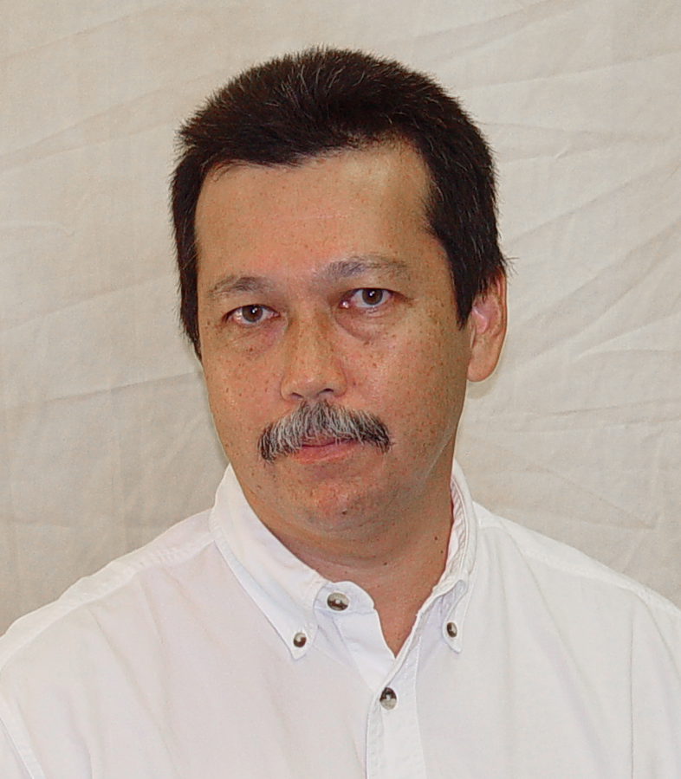
Sponsor and Advisor
Engineering Mentor
Mike Conroy
Florida Space Institute
Academic Advisor
Dr. Patrick Hollis
FAMU-FSU College of Engineering
Evaline Cantarero

Slide 4


Project Background
Florida Space Institute in collaboration with NASA's Swamp Works has asked us to improve the RE-RASSOR
RE-RASSOR is an educational, mainly 3D printed, open-source platform
The solution we produce will be deployed on the educational version, and some ideas may be used by NASA on the full size RASSOR
Evaline Cantarero

Slide 5
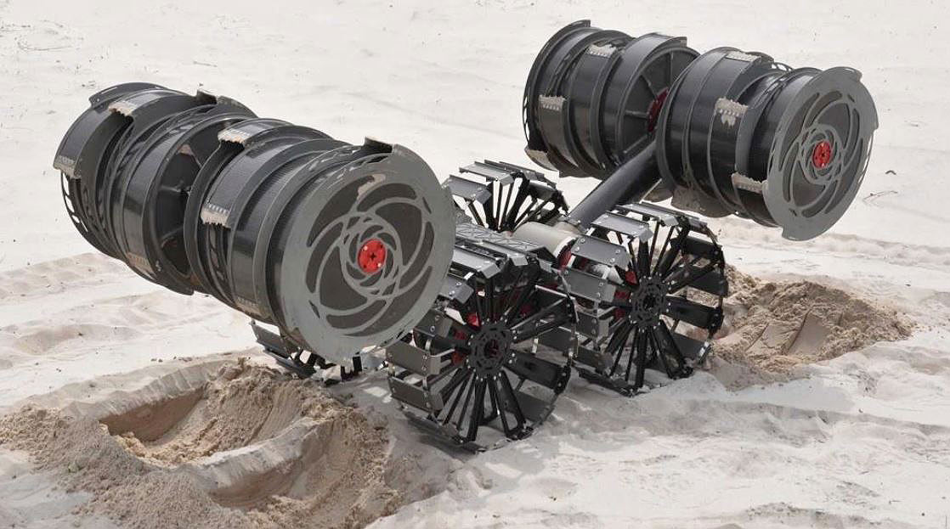
Project Scope
Shoulder
Drives the system
Gearbox
Motor
Arm
Connects the shoulder to the drum
Supports the drum in all operations
Evaline Cantarero

Slide 6
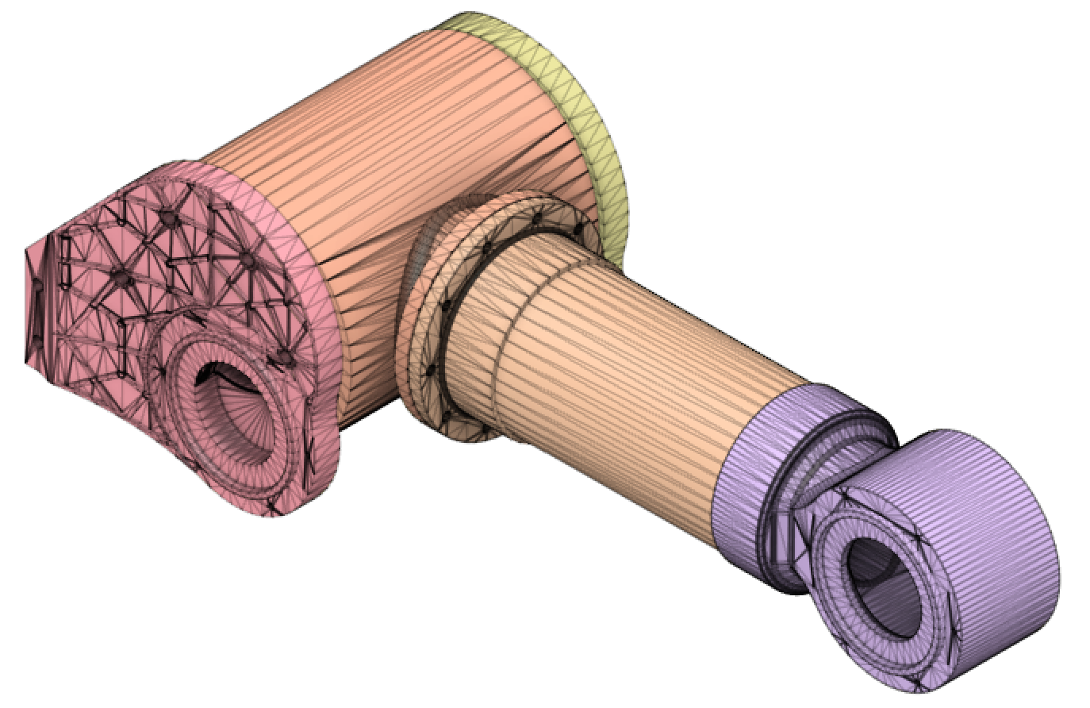
Project Objective
19.05 cm
Redesign the shoulder, arm, and drive components using parts printed out of PLA
Improve durability and cost through innovative technologies and 3D printing processes
41.59 cm
Evaline Cantarero

Slide 7

Customer Needs & Assumptions
Customer Needs
  3D printed PLA parts
  Total cost < $60
  Range of motion and load
Assumptions
  Provided 12 V @ 1.2 A
  Used in earth environment
  Only needs to pivot
Evaline Cantarero

Slide 8
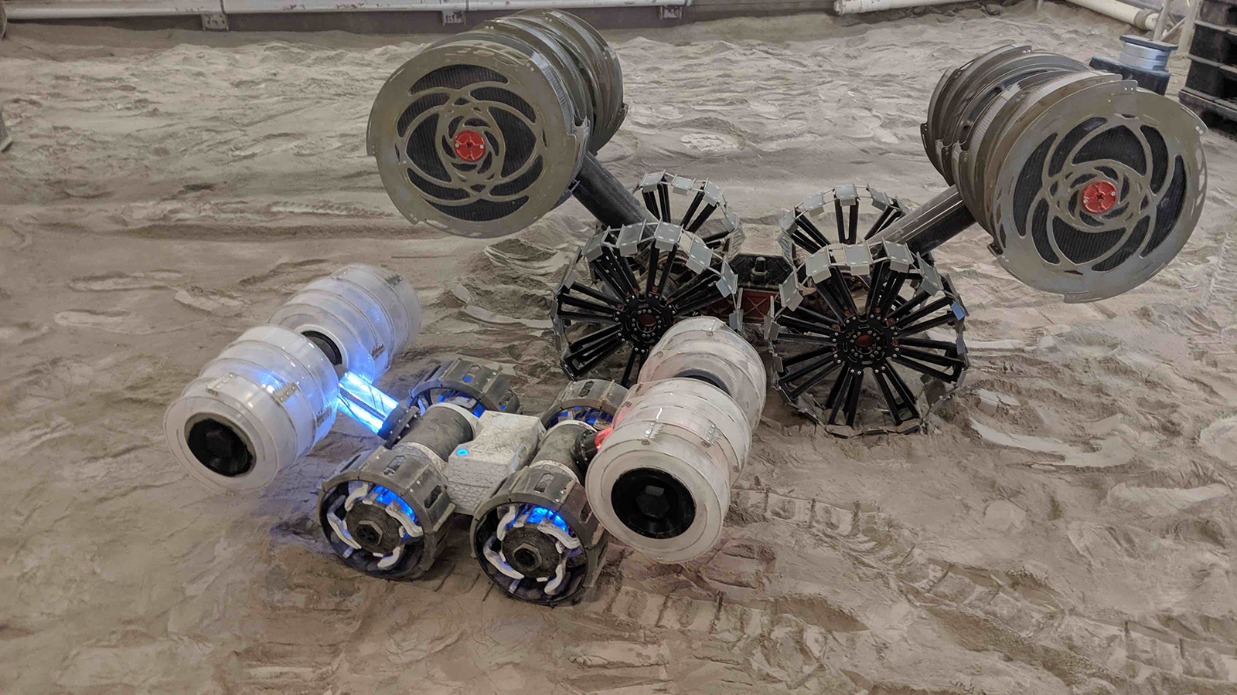
Market & Functional Decomposition
Market
  NASA, Swamp Works, Florida Space Institute
  STEM Education
  Space/Mining Companies
Functional Decomposition
  Source Power
  Support Arm
  Create Motion
Evaline Cantarero

Slide 9
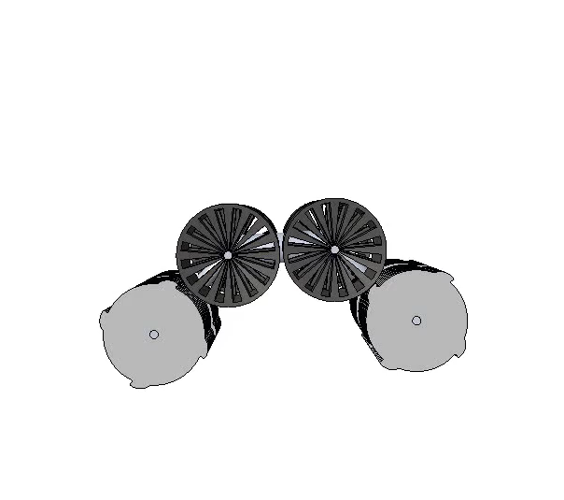
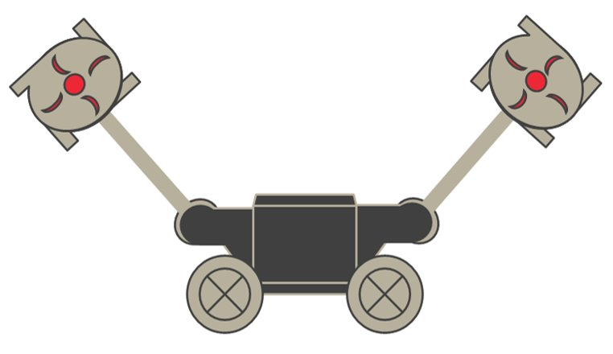
Targets & Metrics
Motion
  Rotates 270 degrees
Power
  12 Volts and 1.2 Amps
Support
  Lift 2x 10-kilogram drums per arm
Evaline Cantarero

Slide 10






Concept Generation
Brain Stroming
Morphological Chart
Biomimicry
Forced Analogy
Evaline Cantarero

Slide 11
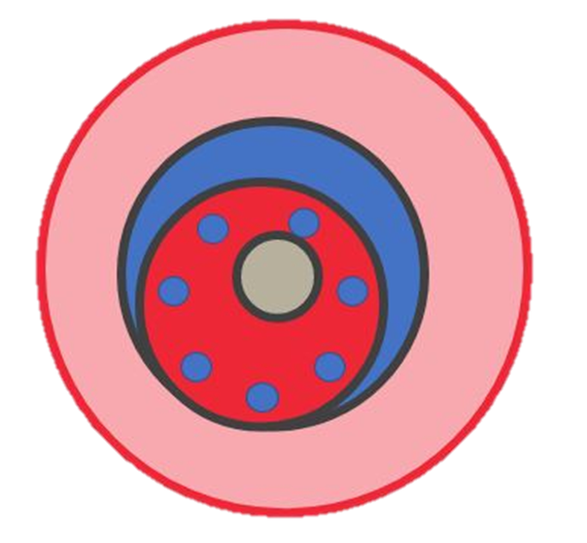


High Fidelity
High Fidelity Concept 1
High Fidelity Concept 2
High Fidelity Concept 3
Stepper motor
Cycloidal drive
transmission
Cylindrical arm
Twin stepper motors
Electromagnetic
brake
Harmonic gearbox
Cylindrical tube
Stepper motor
Worm gearbox
Cylindrical arm
Dowel pin supports
Evaline Cantarero

Slide 12

Concept Selection
Stepper Motor
PLA filament
RAMPS driver
Hybrid gearbox
Tapered cylindrical arm
Evaline Cantarero

Slide 13
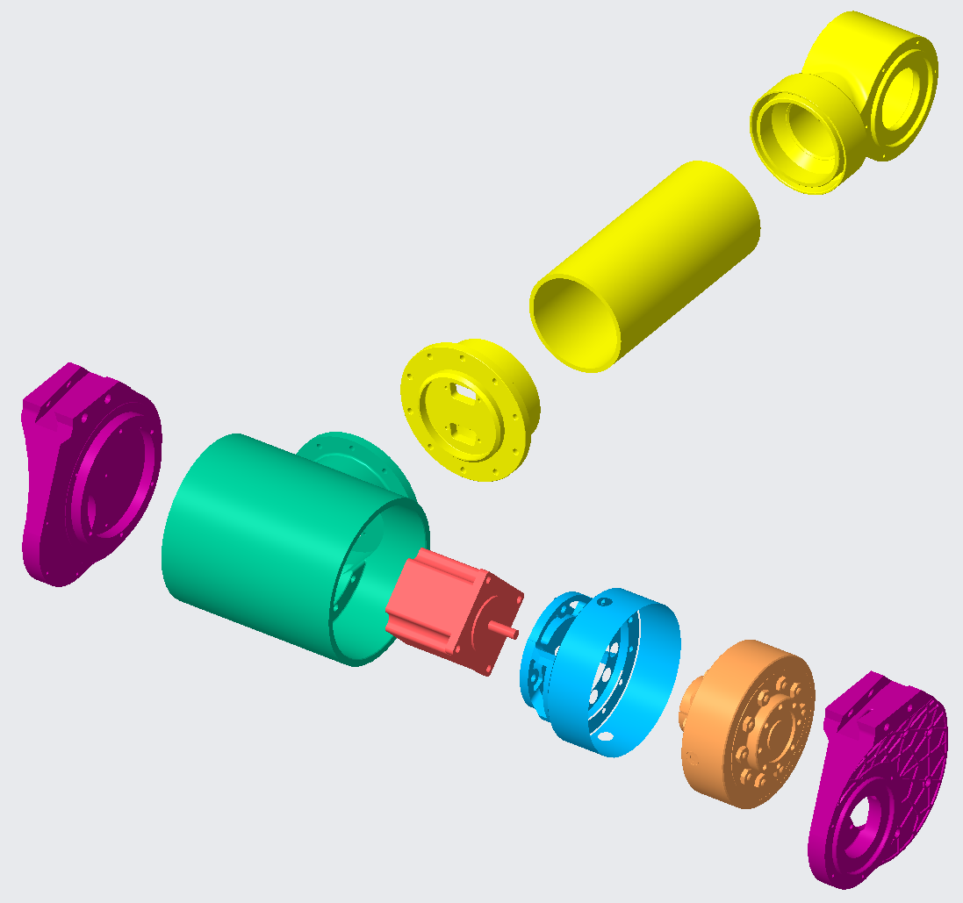
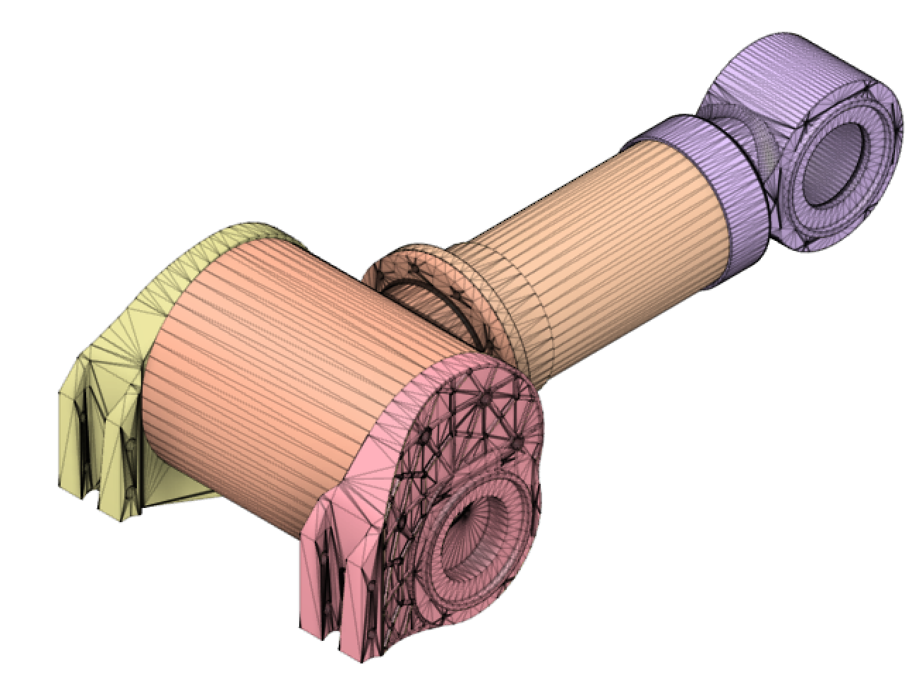
Initial Design
1. T-Joint
2. Shoulder Blade
3. Arm Flange
4. Arm
5. Arm Knuckle
6. Stepper Motor
7. Motor Mount
8. Gearbox
5
4
3
7
2
8
1
2
6
Jackson Davis
Name

Slide 14
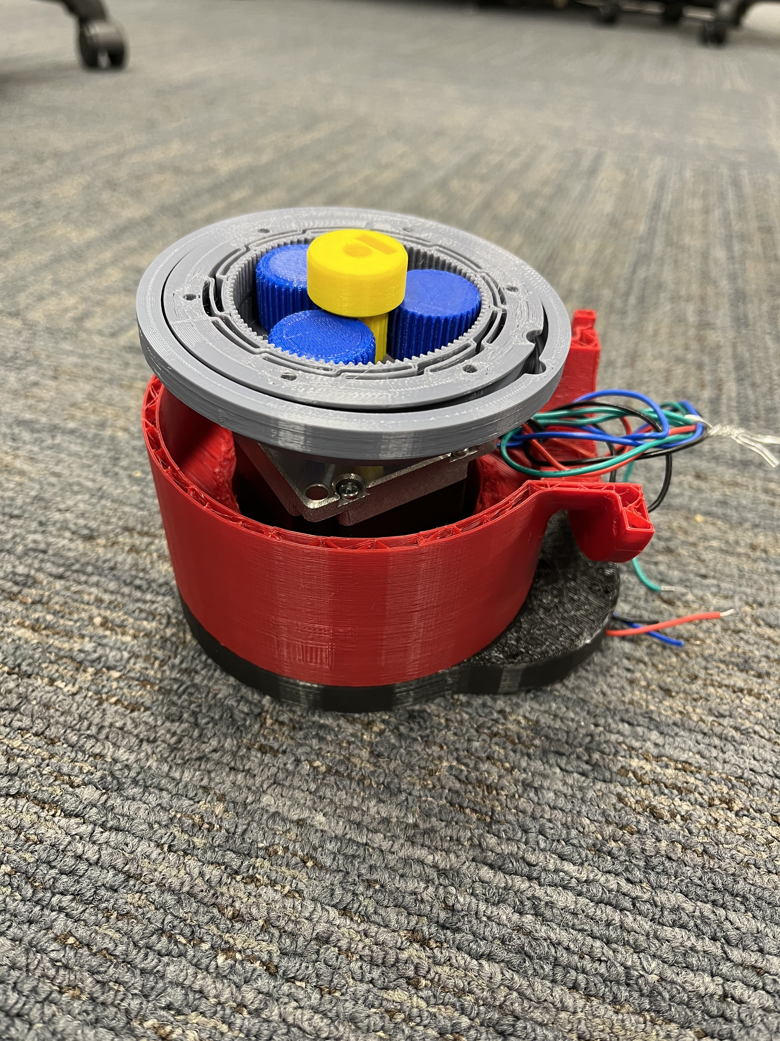
Gearbox
Nema 23 Motor
T-Joint
Should Blade
Jackson Davis

Slide 15
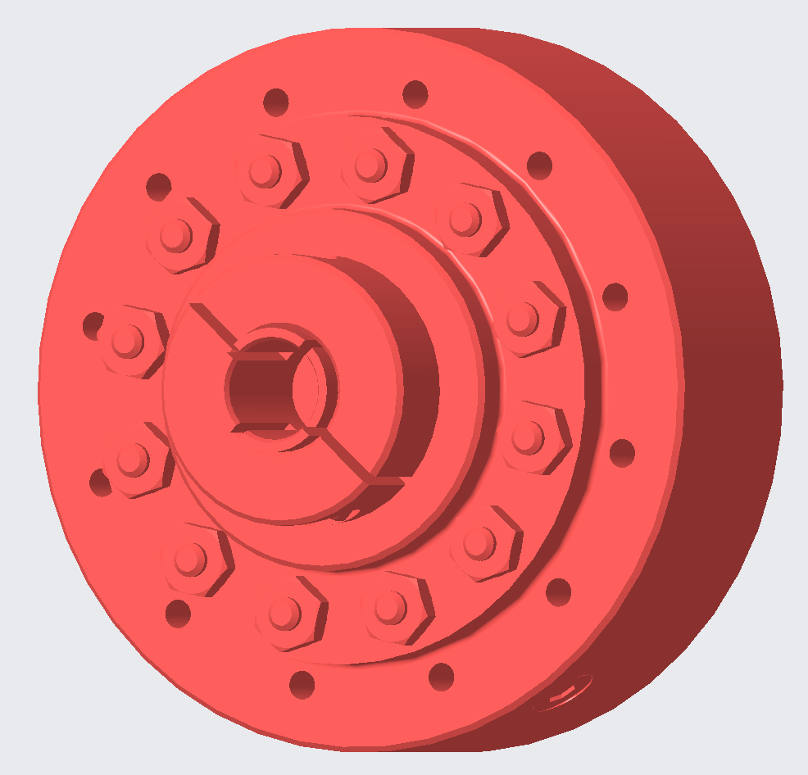
Gearbox Design
Our Designs:
Harmonic
Planetary
Harmonic Planetary Hybrid
Cycloidal
Worm Gear
Jackson Davis

Slide 16
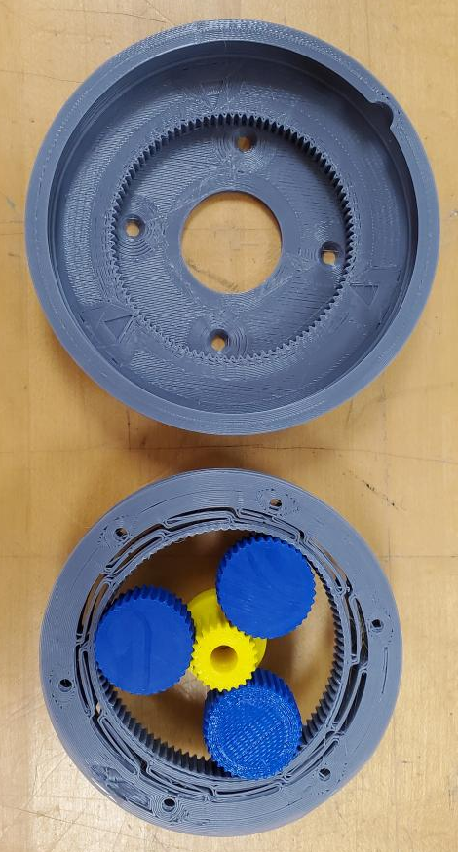
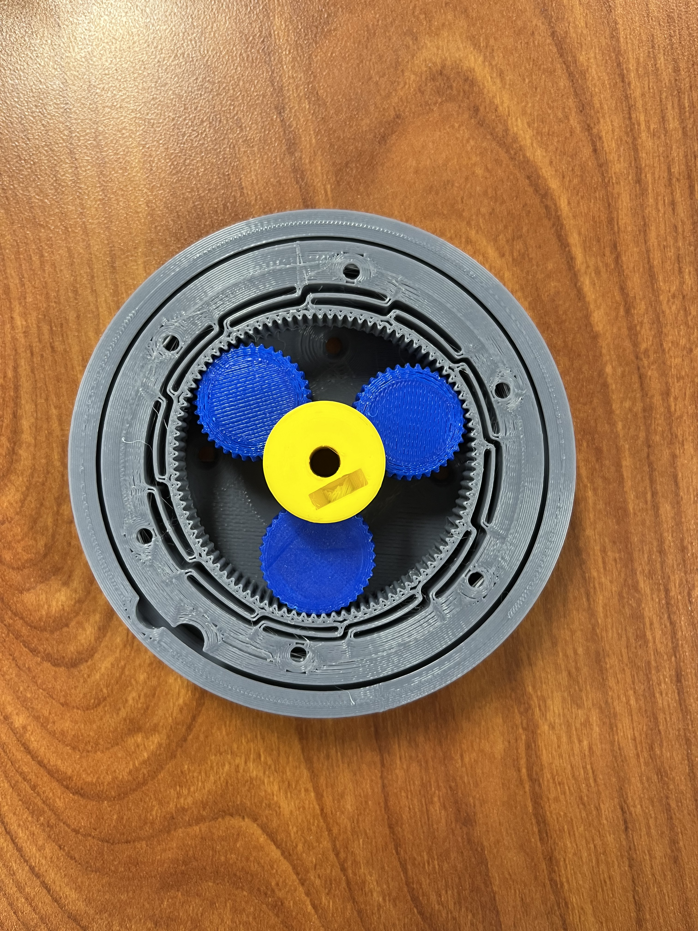
Design 1
10.05 cm
Hybrid Gearbox
Mix between planetary and harmonic
Huge reduction ratio of 155:1
Jackson Davis
Name

Slide 17
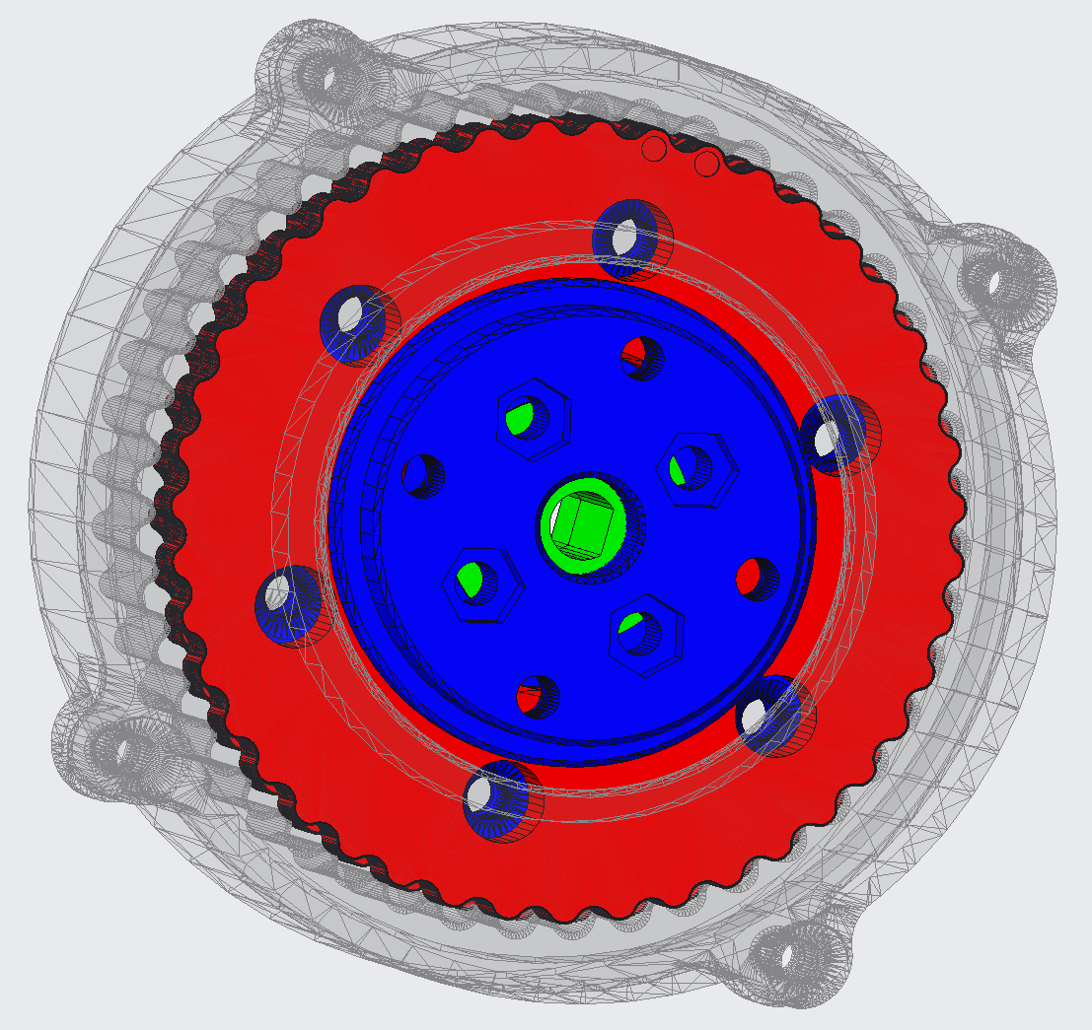
Design 2
Cycloidal Gearbox
Lower friction and less wear on the tooth flanks
Good torsional stiffness and capacity to withstand shocks
48:1 reduction
Jackson Davis
Name

Slide 18
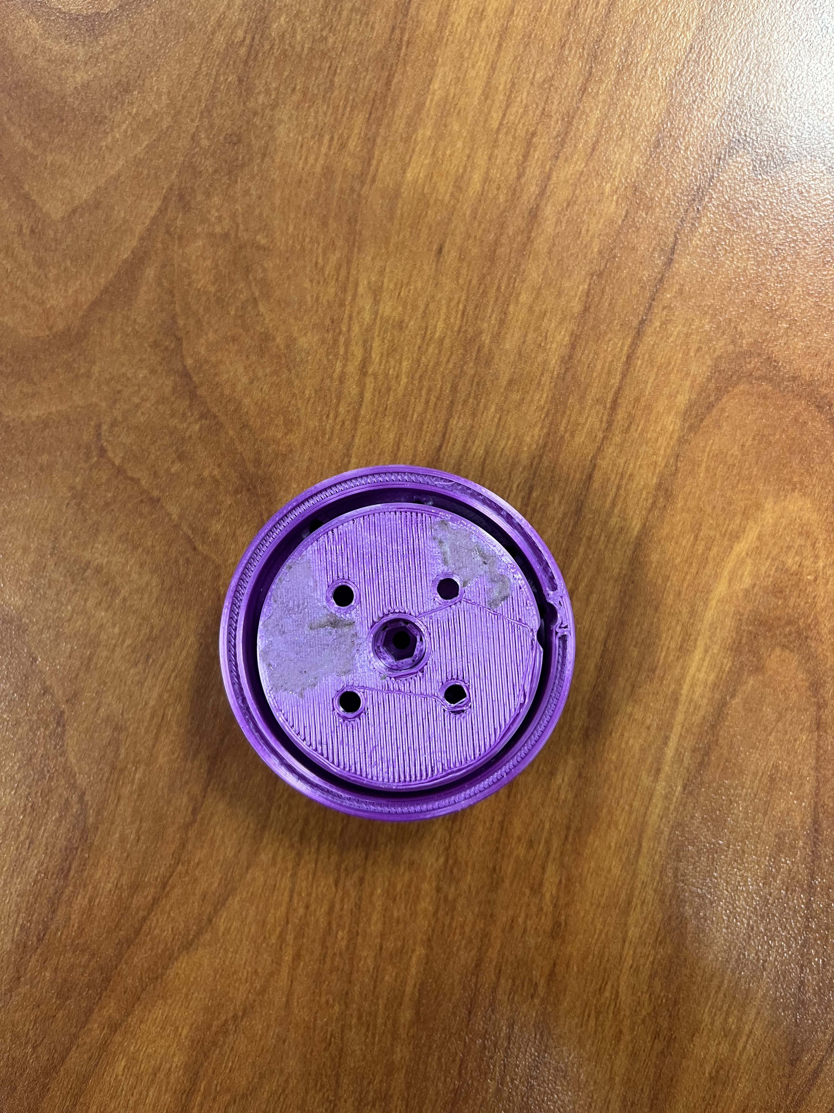
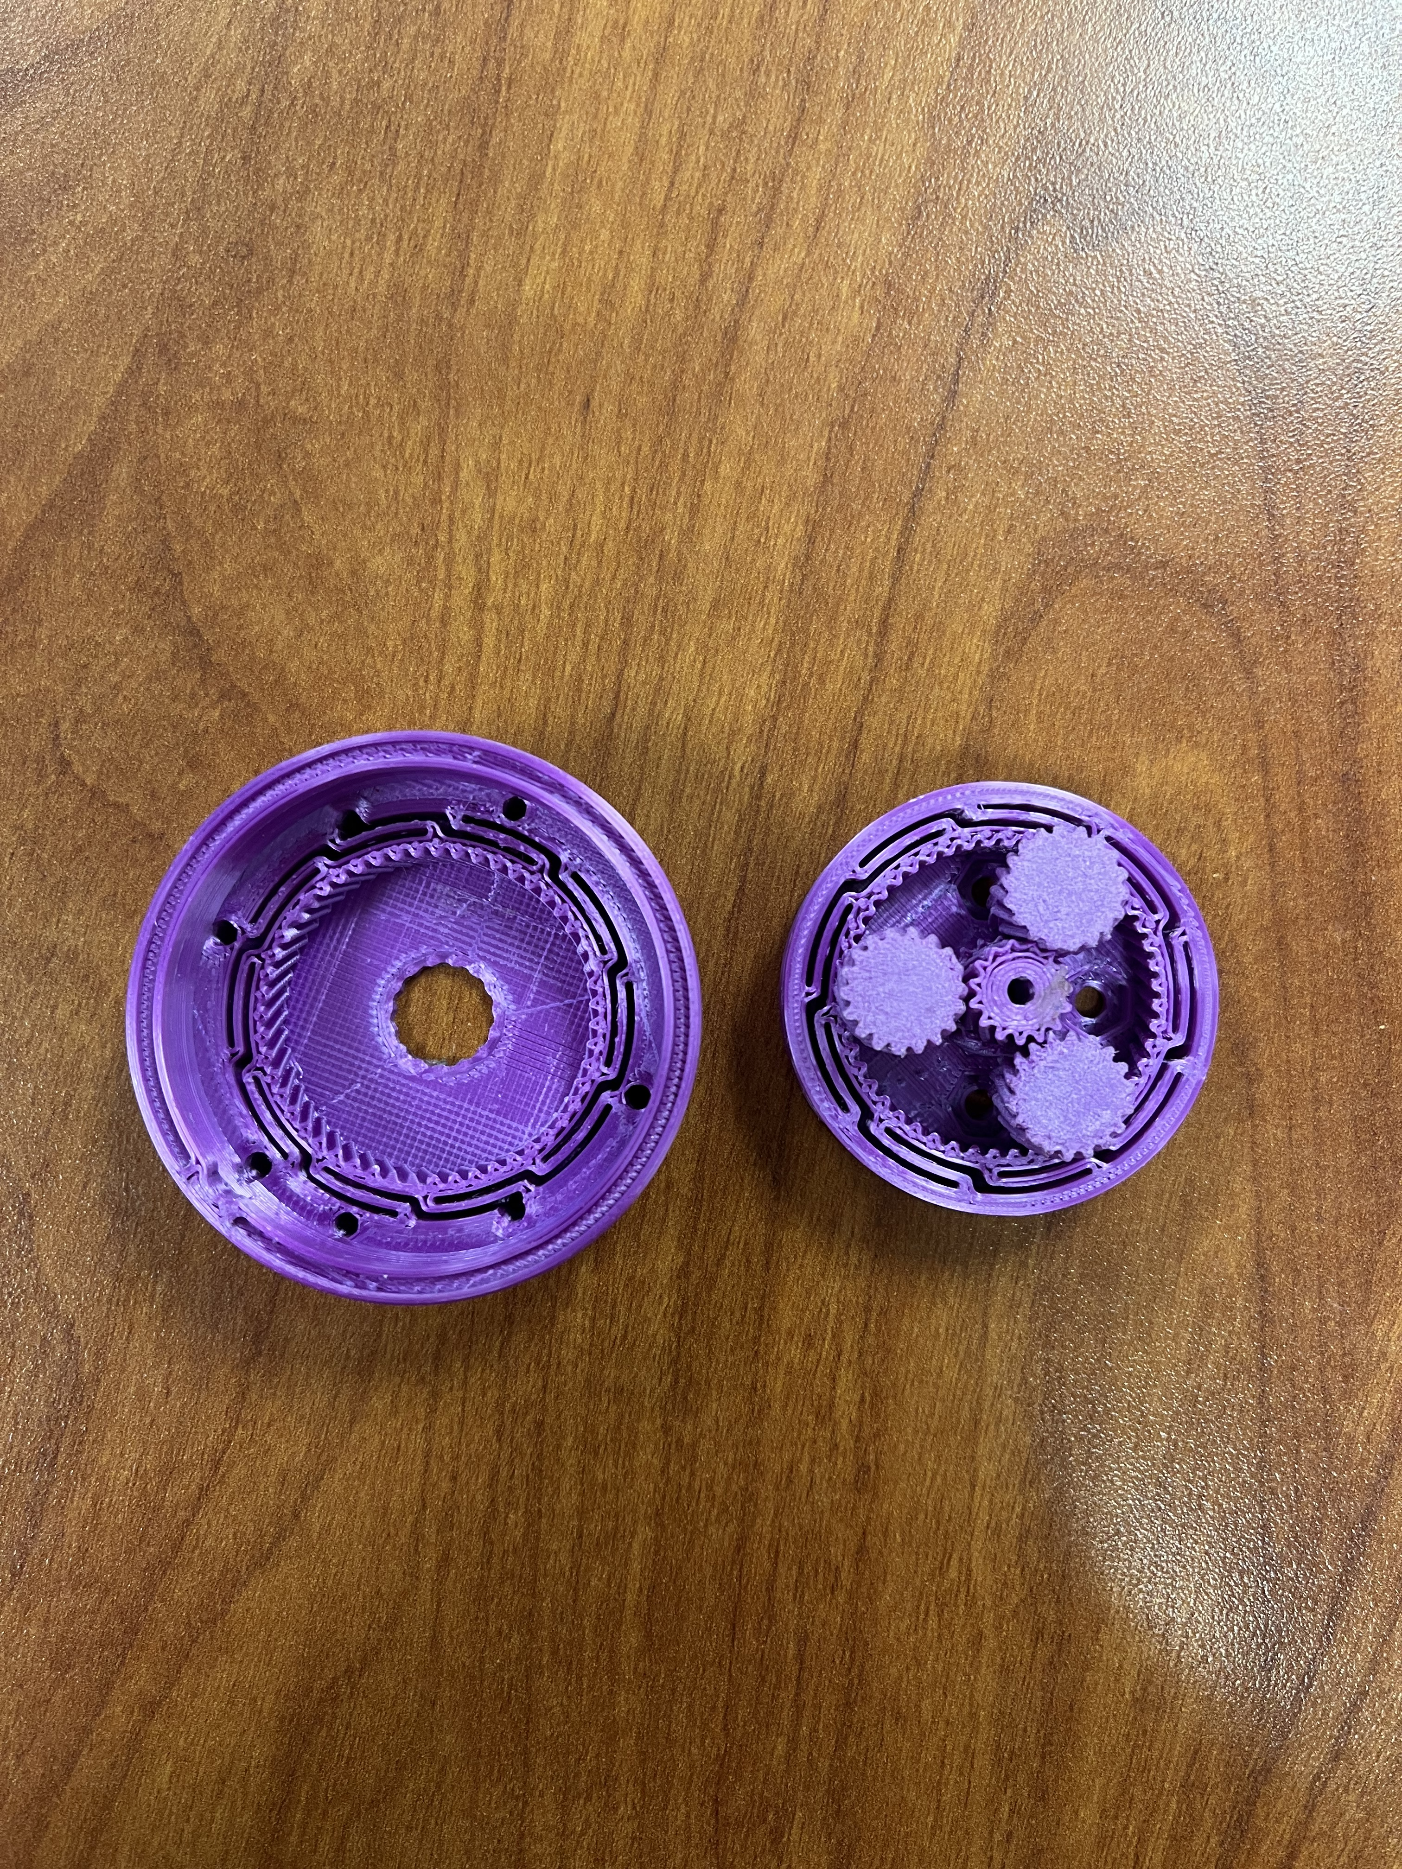
Design 3
Planetary Gearbox
Coaxially aligned input and output shafts make it compact
High torque and low backlash
Capable of high gear ratios with compound gear trains
Current: 3.67:1
5.34 cm
4.25 cm
Jackson Davis

Slide 19
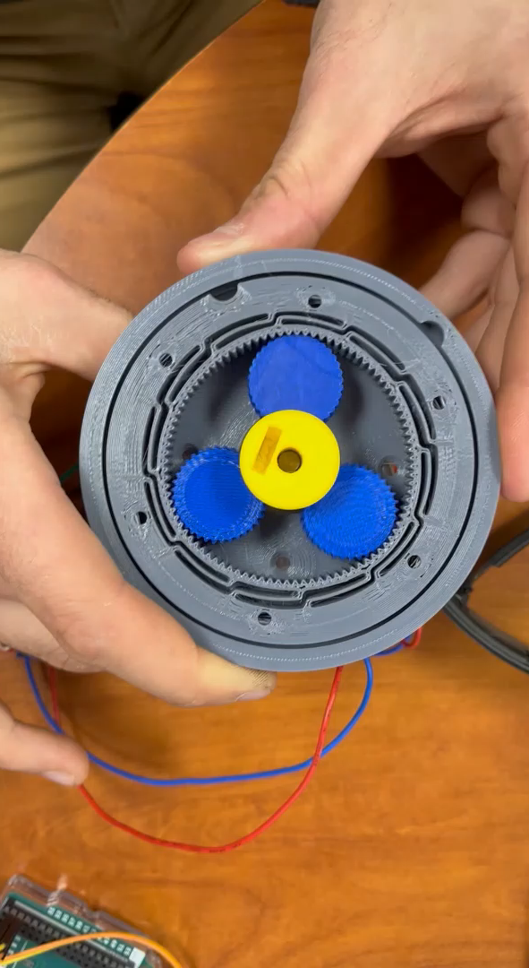
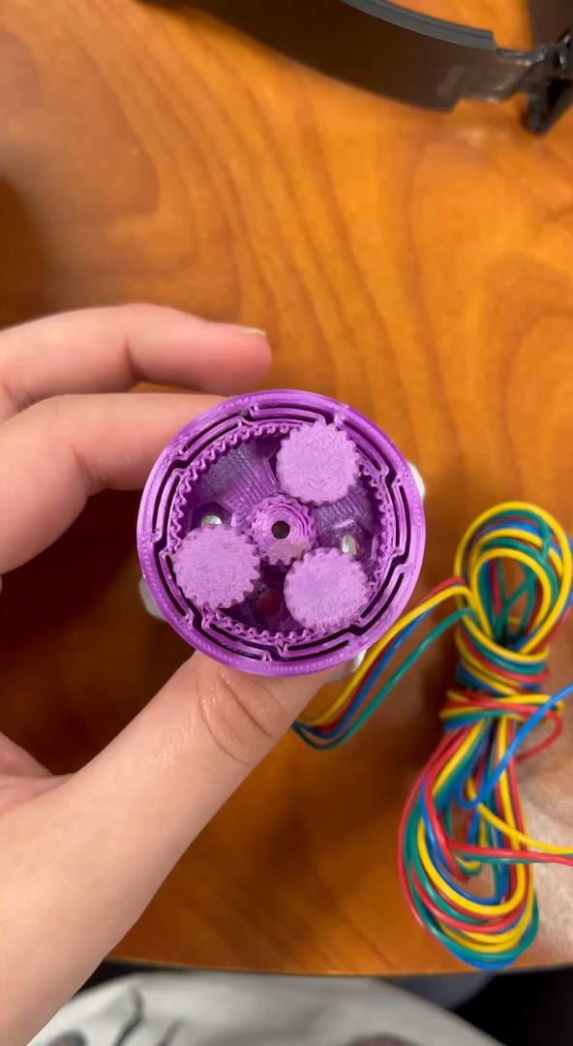
Gearbox Testing
Designing Gearbox
Design testing apparatus
Add weight to apparatus till failure
Ideal Gear Ratio: 50:1
Test motor shaft and gearbox coupler
Jackson Davis

Slide 20

10 kg
10 kg
Jackson Davis

Slide 21
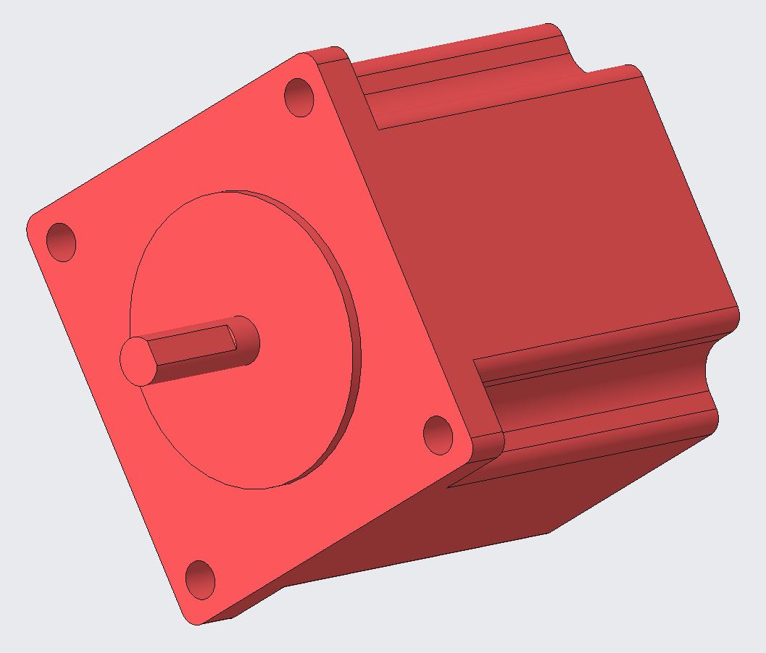
Stepper Motor
Nema 23: 1.2Nm, 3Nm
50mm vs 100mm
Jackson Davis

Slide 22
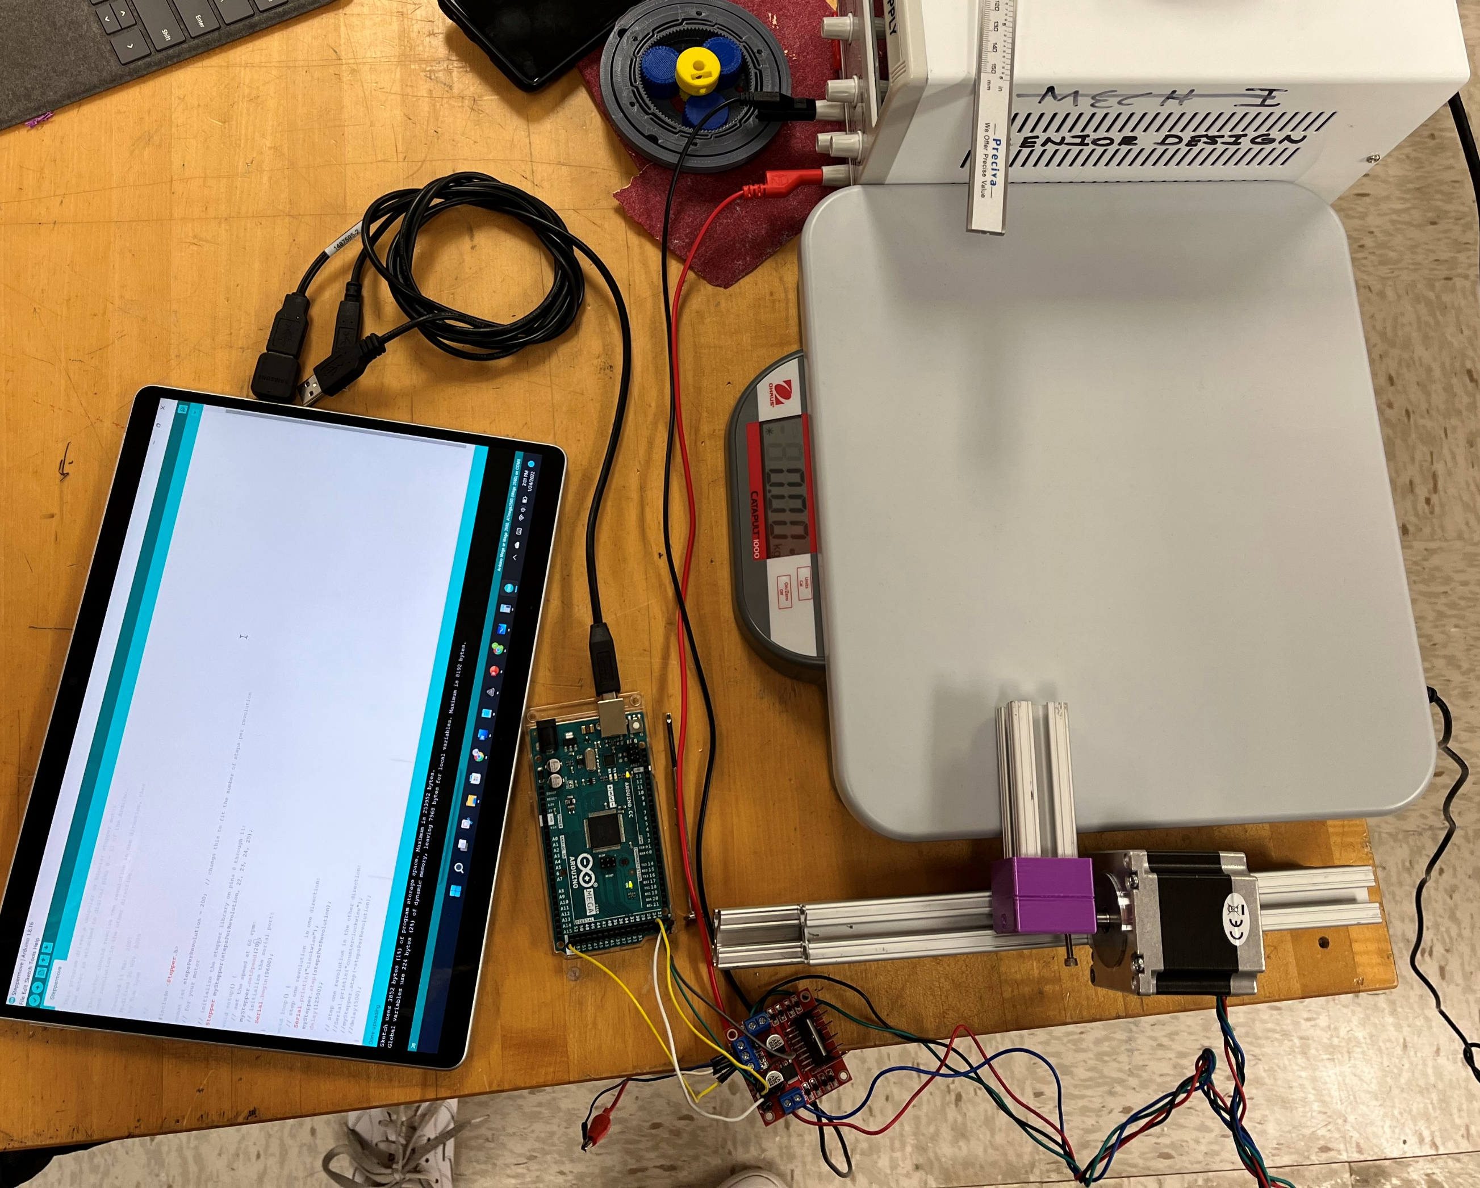
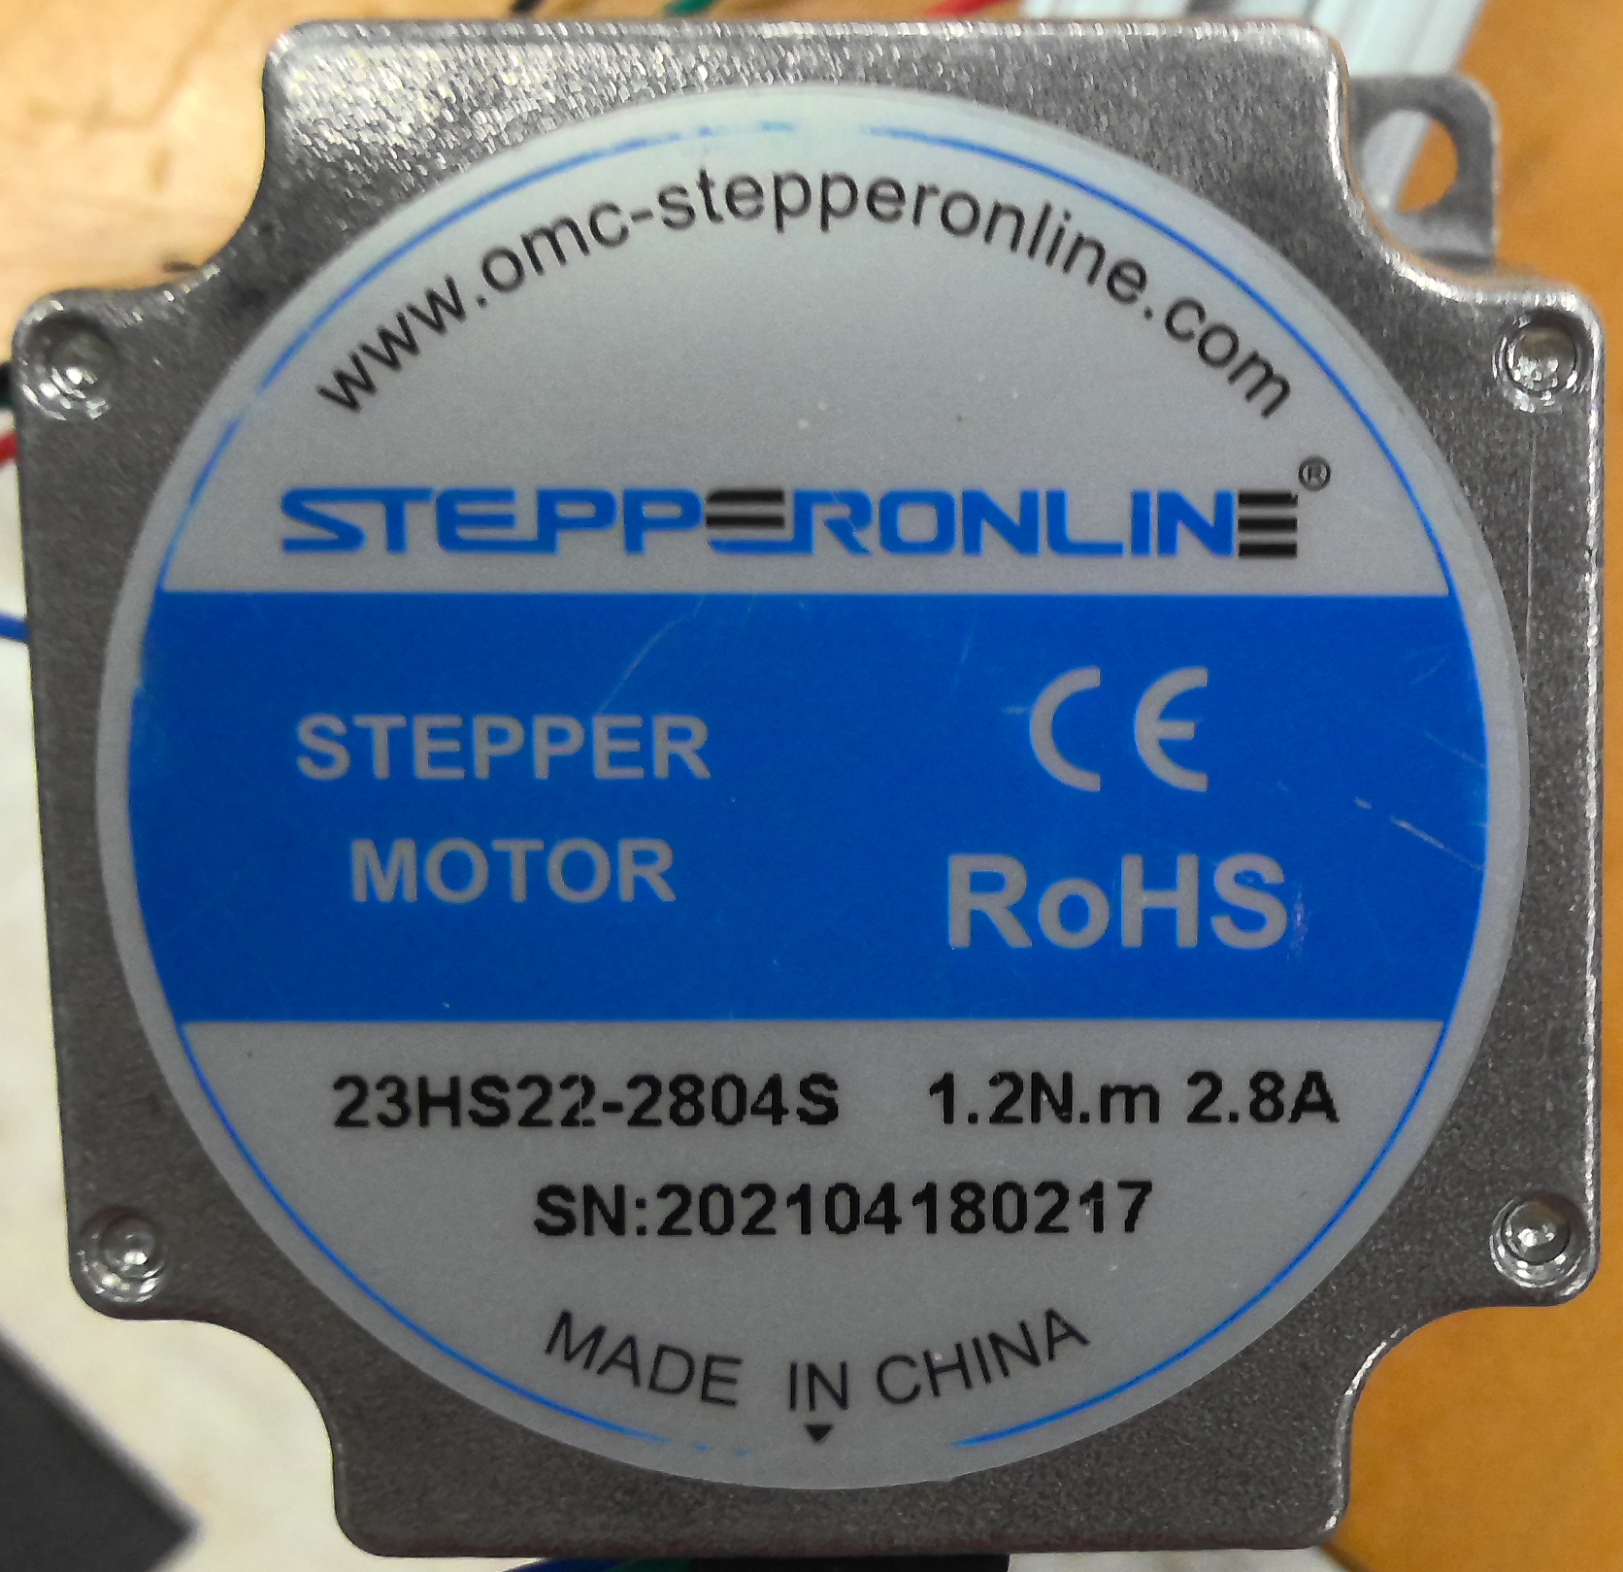
Motor Testing
1.2 Amps, 12 Volts
Provides 0.2 N*m
Jackson Davis

Slide 23
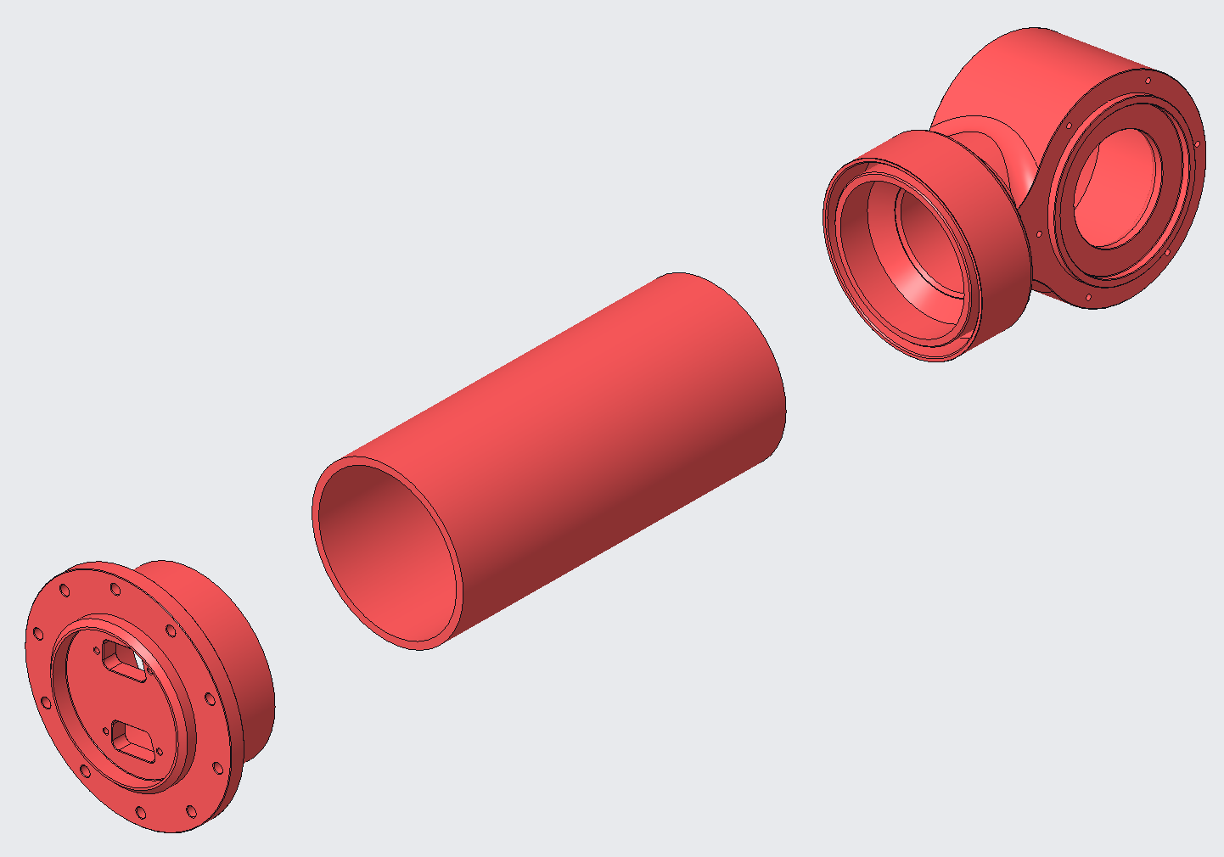
Arm
Design testing apparatus
Mount the arm to the apparatus
Add weight to arm until failure
Insert a bar into arm knuckle
Add weight to bar until failure
Jackson Davis

Slide 24
Jackson Davis

Slide 25






Determine Specs
Determining Specs
Voltage &
Current
Weight of Components
Weight of Loaded Drum
Gear Ratio
Torque
Evaline Cantarero

Slide 26
Future Work
Determine Specs
Rapid Prototyping
Failure Testing
Torque Analysis
Evaline Cantarero

Slide 27
References
Showcase, A. P. (2021, August 6). 2020 RE-RASSOR ARM. Florida Space Institute. Retrieved September 13, 2021, from https://fsi.ucf.edu/2020re-rassorarm/.
Showcase, A. P. (2021, August 6). 2020 RE-RASSOR Gold team. Florida Space Institute. Retrieved September 13, 2021, from https://fsi.ucf.edu/2020goldteam/.

Slide 28
Backup Slides

Slide 29
Concept Selection

Slide 30
Embodiment
Upcoming Presenter’s Name

Slide 32
Manufacturing
Upcoming Presenter’s Name

Slide 34
Testing
Upcoming Presenter’s Name

Slide 36
Project Management

Slide 38
# Most Important Points
The quick brown fox jumps over the lazy dog.
The quick brown fox jumps over the lazy dog.
The quick brown fox jumps over the lazy dog.
The quick brown fox jumps over the lazy dog.
The quick brown fox jumps over the lazy dog.
The quick brown fox jumps over the lazy dog.

Slide 39
Lessons Learned
Don’t make these start earlier test earlier and so on.

Slide 40
Questions (be sure to design your own)

Slide 44
College of Engineering Color Palette
2299 C
Color Values:
RGB 164 210 51
Hex/HTML #A4D233
CMYK 41 0 84 0
1788 C
Color Values:
RGB 238 39 55
Hex/HTML #EE2737
CMYK 0 88 82 0
75% Black
Color Values:
RGB 64 64 64
Hex/HTML #404040
CMYK 0 0 0 75
Pantone
2299 C
Pantone
1788 C
CoE Dk Gray
2239 C
Color Values:
RGB 0 207 180
Hex/HTML #00CFB4
CMYK 59 0 39 0
647 C
Color Values:
RGB 35 97 146
Hex/HTML #236192
CMYK 96 54 5 27
50% Black
Color Values:
RGB 128 128 128
Hex/HTML #808080
CMYK 0 0 0 50
Pantone
2239 C
Pantone
647 C
CoE Md Gray
2199 C
Color Values:
RGB 0 187 220
Hex/HTML #00BBDC
CMYK 77 0 16 0
7535 C
Color Values:
RGB 183 176 156
Hex/HTML #B7B09C
CMYK 10 11 23 19
25% Black
Color Values:
RGB 191 191 191
Hex/HTML #bfbfbf
CMYK 0 0 0 25
Pantone
2199 C
Pantone
7535 C
CoE Lt Gray
Notes:
Theses are the official color palettes of the college of engineering.

Slide 45
PowerPoint Color Theme
Accent1
647 C
Color Values:
RGB 35 97 146
Hex/HTML #236192
CMYK 96 54 5 27
Accent4
2239 C
Color Values:
RGB 0 207 180
Hex/HTML #00CFB4
CMYK 59 0 39 0
Light 1
White
Color Values:
RGB 255 255 255
Hex/HTML #FFFFFF
CMYK 0 0 0 0
Dark 1
100% Black
Color Values:
RGB 0 0 0
Hex/HTML #000000
CMYK 0 0 0 100
Pantone
647 C
Pantone
2239 C
White
Black
Accent 2
2199 C
Color Values:
RGB 0 187 220
Hex/HTML #00BBDC
CMYK 77 0 16 0
Accent5
7535 C
Color Values:
RGB 183 176 156
Hex/HTML #B7B09C
CMYK 10 11 23 19
Light 2
25% Black
Color Values:
RGB 191 191 191
Hex/HTML #bfbfbf
CMYK 0 0 0 25
Dark 2
75 % Black
Color Values:
RGB 64 64 64
Hex/HTML #404040
CMYK 0 0 0 75
Pantone
2199 C
Pantone
7535 C
CoE Lt Gray
CoE Dk Gray
Accent3
1788 C
Color Values:
RGB 238 39 55
Hex/HTML #EE2737
CMYK 0 88 82 0
Accent6
2299 C
Color Values:
RGB 164 210 51
Hex/HTML #A4D233
CMYK 41 0 84 0
Pantone
1788 C
Pantone
2299 C
Notes:
These are the college colors as prioritized within this PowerPoint Template

Slide 46
Notes:
This slide has the rule of third layout tool. The rule thirds layout helps with the sizing of elements.

Slide 47
Notes:
This slide has the rule of third layout tool. The rule thirds layout helps with the sizing of elements.

